Slide 1
Round Table
By: Madison Lutz

Slide 2
Element Bending Simulation

Slide 4
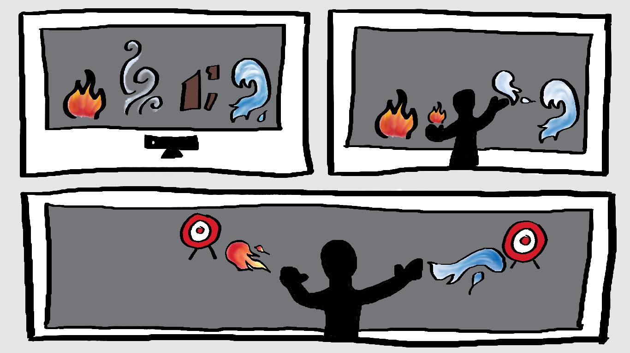

Slide 5
Synesthesia

Slide 6
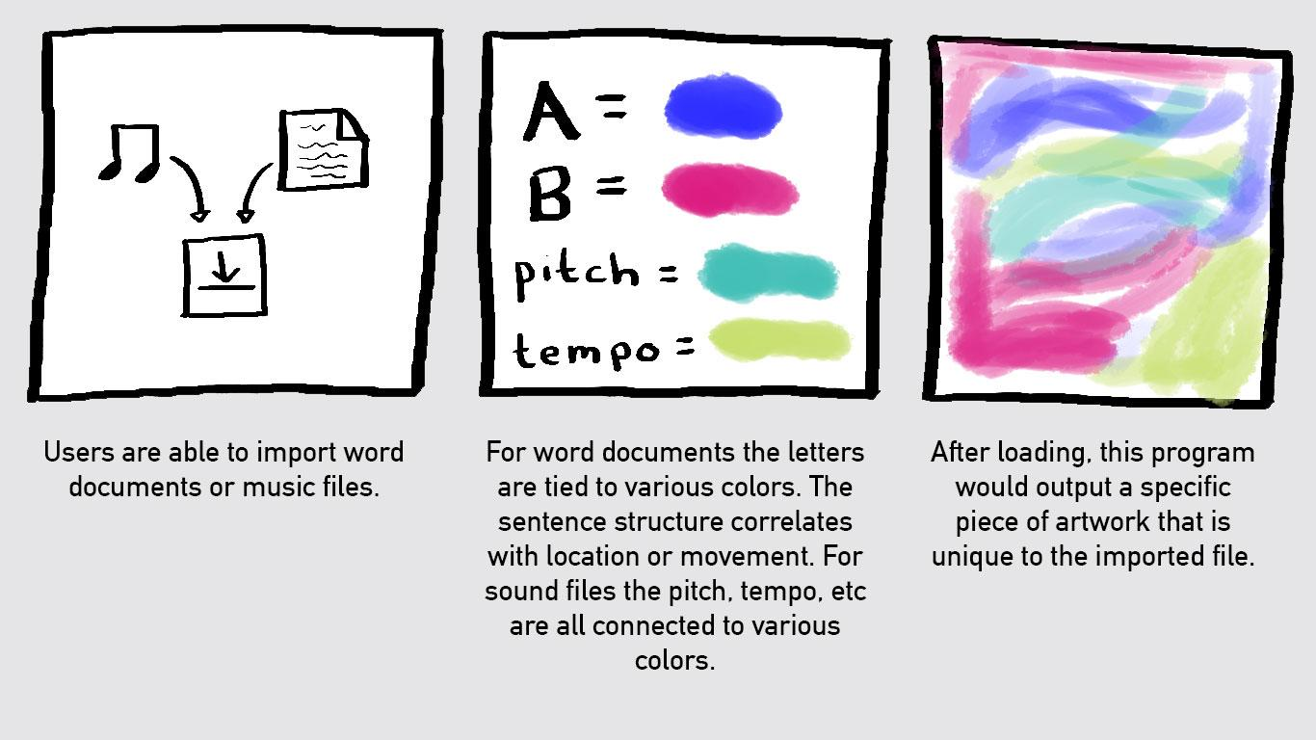

Slide 7
The Dynamics of Light

Slide 8
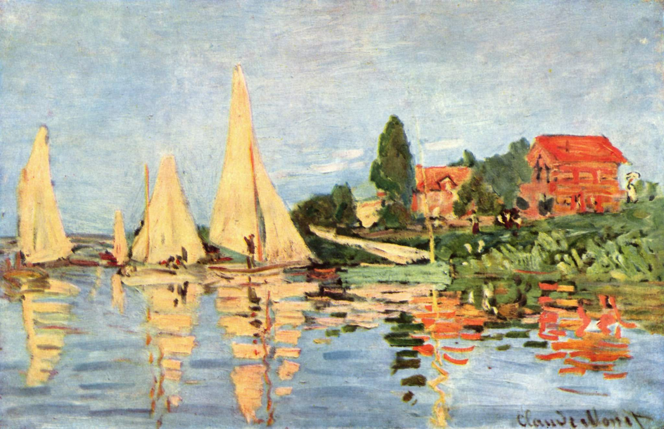
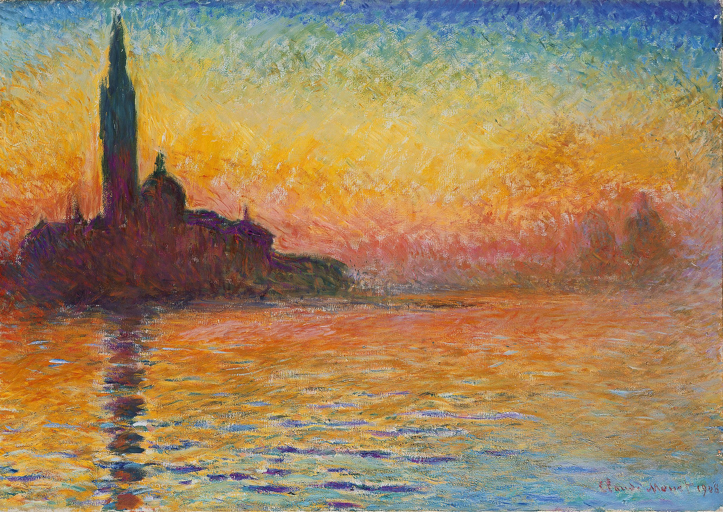
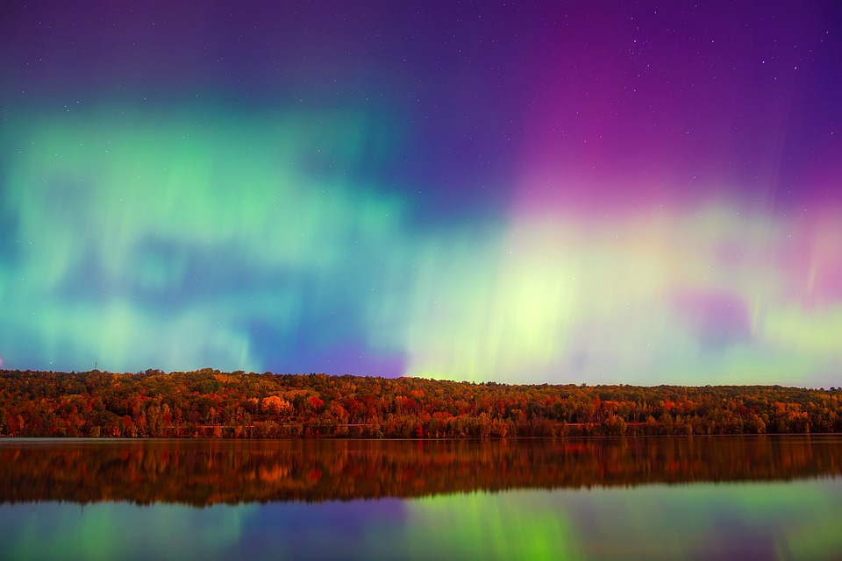
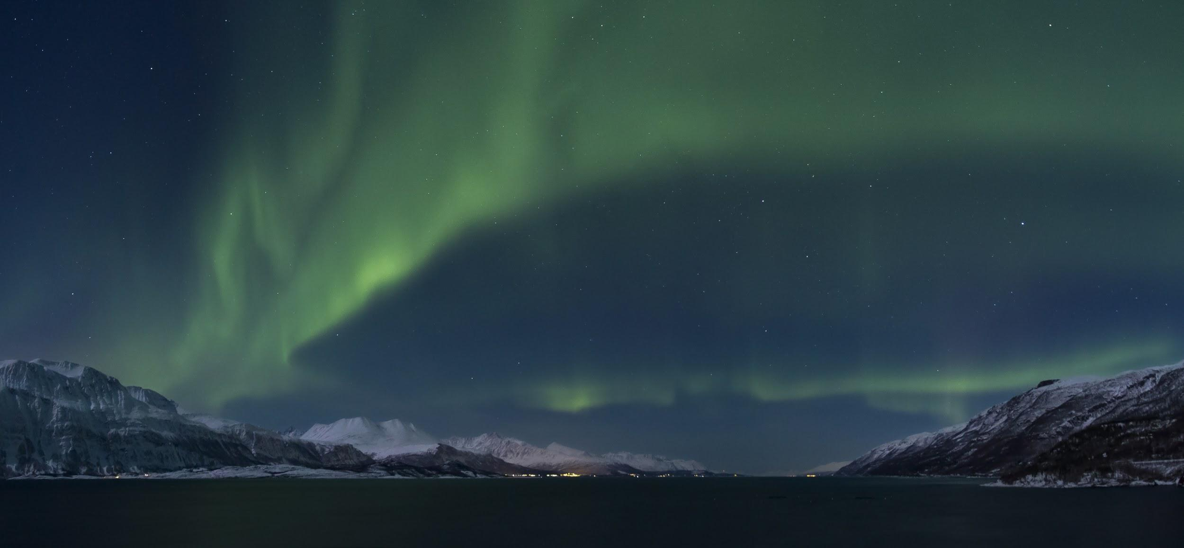

Slide 9
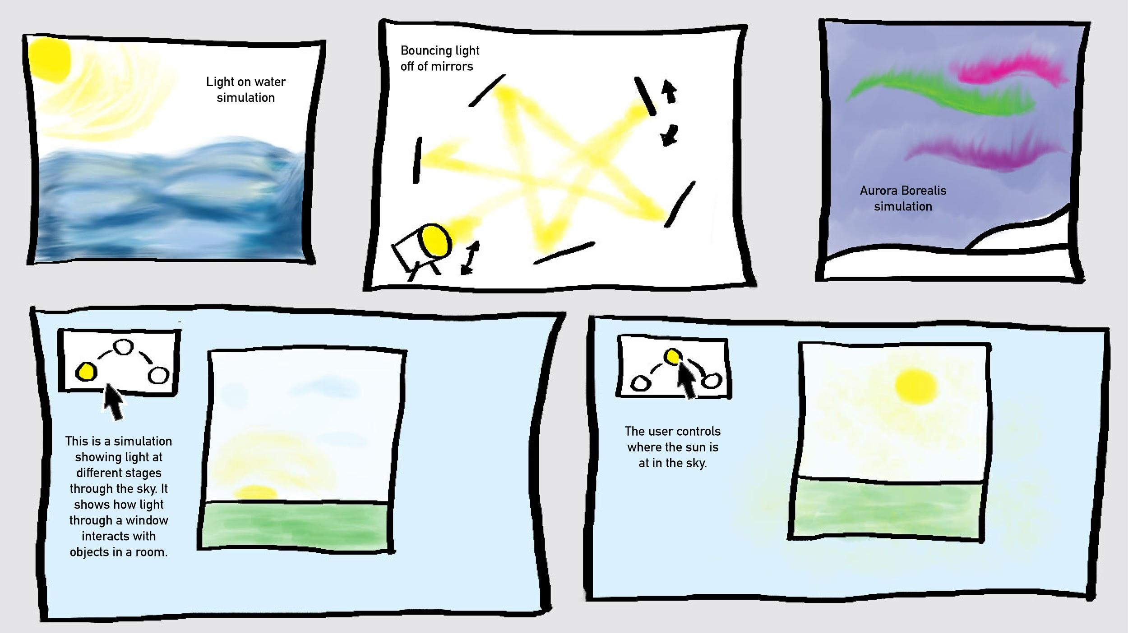

Slide 10
Interactive Children’s Book

Slide 11
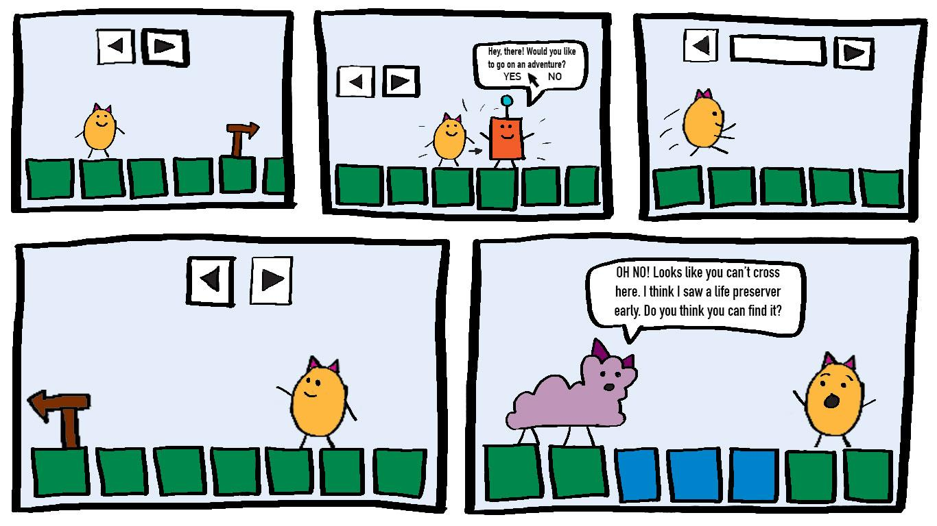

Slide 12
Inspiration Links (Element bending)
Interaction with a Large Screen
Motion Capture

Slide 13
Inspiration Links (Synethesia)
Color Mixing with Sound
Abstractions of Color
User Input

Slide 14
Inspiration Links (Dynamics of Light)
Aurora Borealis
Light as a Wave
Claude Monet
Light and Movement
Assigning Light Value to a Property
Working with Actual Lights

Slide 15
Inspiration Links (Interactive Storybook)
p5.play Animation style
RPG style
Storybook Narrative
Mini-Games & Interaction

